Slide 1
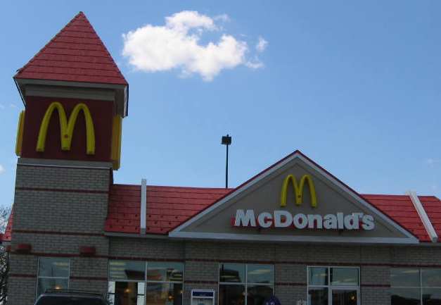
Chapter 1: Economic Basics 1.1 What Is a Business?
Businesses come in many shapes and sizes, such as local, regional, national, and/or global. They are classified by their size, structure, and the role they play in the community.
Profit or Non-profit?
For-Profit Business
A for-profit business produces or sell goods and services to satisfy the needs, wants, and demands of consumers for the purpose of a making profit.
Non-profit and Not-for-profit Organizations
A non-profit and/or not-for-profit organization operates strictly to help people in a community. (charities)

Slide 2
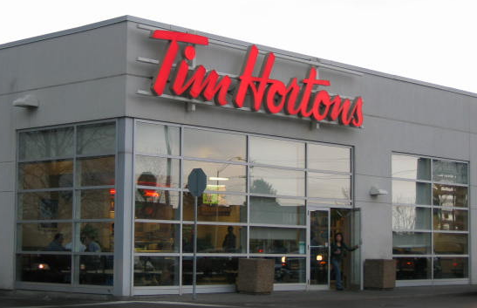
Chapter 1: Economic Basics 1.1 What Is a Business?
For-profit Business
By supplying goods and services, a business can make a profit.
Profit is the income left after all costs and expenses are paid.
Expenses are the payments involved in running a business and the assets that get “used up” operating it.
Cost is the money required to produce or provide the goods and services.
Revenue – Expenses = Profit (or Loss)
Notes:
FOR PROFIT BUSINESS
Expenses: expenditures such as wages and “used up” assets such as paper and chalk
Costs: raw materials
To achieve cost reduction businesses can reduce their payroll (wages paid to employees) by decreasing staff, however they may compromise customer service (fewer people to serve customers) actually causing sales (thus profit) to decline.
Business’s strive to keep expenses and costs down.
As costs and expenses increase, the business’s profits get smaller.
Businesses need to be efficient and organized.
Solvency: means having the ability to pay all business debts and financial obligations.
To stay profitable businesses need to anticipate and prepare for the changing needs and wants of consumers.

Slide 3
Chapter 1: Economic Basics 1.1 What Is a Business?
When a business makes a profit, it can
reinvest money for expansion
provide improved goods and services
give the owner(s) funds to spend on personal needs or wants
The business is considered solvent when debts are paid and financial obligations are met.
Notes:
FOR PROFIT BUSINESS
Expenses: expenditures such as wages and “used up” assets such as paper and chalk
Costs: raw materials
To achieve cost reduction businesses can reduce their payroll (wages paid to employees) by decreasing staff, however they may compromise customer service (fewer people to serve customers) actually causing sales (thus profit) to decline.
Business’s strive to keep expenses and costs down.
As costs and expenses increase, the business’s profits get smaller.
Businesses need to be efficient and organized.
Solvency: means having the ability to pay all business debts and financial obligations.
To stay profitable businesses need to anticipate and prepare for the changing needs and wants of consumers.

Slide 4
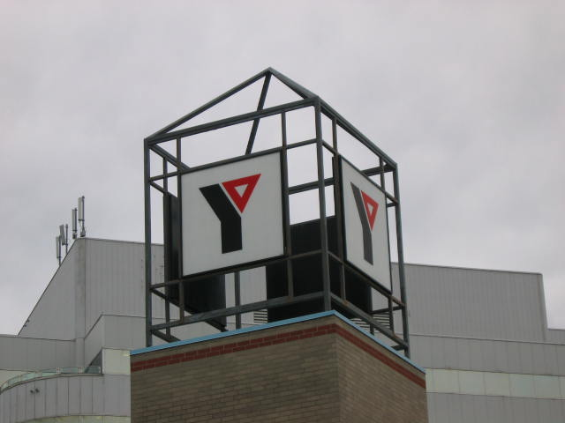
Chapter 1: Economic Basics 1.1 What Is a Business?
Non-profit Organizations
The primary motive of a non-profit organization is to raise funds for a specific goal. Only charities and charitable organizations are called non-profit and are allowed to raise such funds. These organizations operate to serve people and their communities.
Not-for-profit Organizations
\A not-for-profit organization uses any surplus funds to improve the services offered to its members. However, they do not distribute profits to members. A co-operative, unlike a not-for-profit organization, consists of an independent association of persons who join together to meet economic, social, and cultural needs and goals.
Notes:
NON-PROFIT ORGANIZATIONS
Non-profit (charity/charitable) include the Canadian Breast Cancer Foundation that raises funds through events such as the CIBC Run for the Cure. They in turn advance research, education, diagnosis and treatment.
Not-for-profit-housing and childcare.
NOT-FOR-PROFIT ORGANIZATIONS

Slide 5
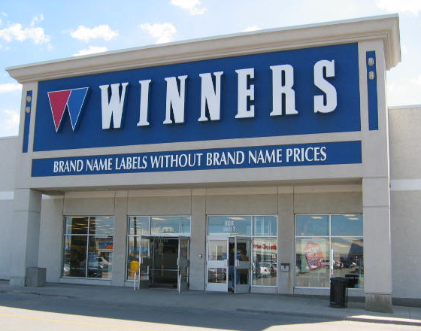
Chapter 1: Economic Basics 1.1 What Is a Business?
Large or Small
A small or medium-sized business (SMB) can be classified by the following characteristics:
employs fewer than 500 people
estimated to be over one million in Canada
provides jobs for more than 60 percent of the Canadian workforce
Forms of Business Ownership
Informal descriptions of business ownership include:
sole proprietorship
partnership
corporation
co-operative
franchise
Notes:
LARGE OR SMALL
FORMS OF BUSINESS OWNERSHIP
Sole proprietorship: owned by one person
Partnership: owned by two or more partners
Corporation: an artificial “person” created by law and owned by shareholders
Co-operative: owned by its workers or members who buy from the business
Franchise: when a business licenses another to use its name, operating procedure, etc. under an above form of ownership

Slide 6
Chapter 1: Economic Basics 1.1 What Is a Business?
Goods or Services
A business can be classified by the goods that it produces or services that it offers. Best Buy sells electronic goods while a local food bank provides a service to the community.
Notes:
LARGE OR SMALL
FORMS OF BUSINESS OWNERSHIP
Sole proprietorship: owned by one person
Partnership: owned by two or more partners
Corporation: an artificial “person” created by law and owned by shareholders
Co-operative: owned by its workers or members who buy from the business
Franchise: when a business licenses another to use its name, operating procedure, etc. under an above form of ownership

Slide 7
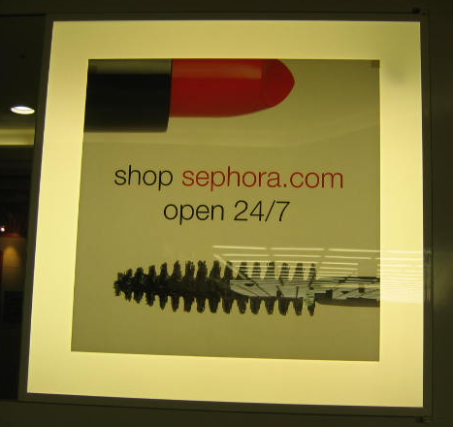
Chapter 1: Economic Basics 1.1 What Is a Business?
Channels of Distribution
A business can be classified according to how it delivers goods or services to the customer. Some of these categories are
retail (“bricks and mortar”)
the telephone
catalogues
e-commerce
Role in the Community
A business performs different functions in its community.
Jobs
A business can be classified by the types of jobs that it provides. For example, a health club provides jobs to personal trainers, front desk workers, office workers, maintenance workers, and possibly food service personnel.

Slide 8
Your Thoughts
Describing a Business
Describe a business you’re familiar with. In your description, tell about its purpose (profit or non-profit), its size, how it’s owned (if you know), the goods or services that it provides, how it delivers its goods or services, its role in the community, and the kind of jobs it provides.

Slide 9
Chapter 1: Economic Basics 1.2 The Role of the Consumer
Producers are the businesses that make goods or provide services that consumers need or want.
Consumers are the people who purchase goods and services from producers.
A marketplace or location is where producers and consumers come together to buy and sell their goods and services.
Businesses use consumer habits plus their own research to decide what quantities of goods and services they will provide to consumers.
Some key questions that businesses might ask about themselves are
When do they want these goods and services?
Where do they want them?
How much goods or services do they want?
What price will they pay for these goods and services?
Notes:
Stew Leonard’s store-front message: Ask students if they agree, if they think that businesses really function this way and if they could suggest businesses that do not follow these rules?
Rule#1: The customer is always right.
Rule#2: If the customer is wrong, re-read Rule#1.
Examples:
A cookie manufacturer is the producer of a good, while the business that services their machinery provides a service.
A marketplace would include a mall, farmer’s market, or a grocery store.

Slide 10
Chapter 1: Economic Basics 1.2 The Role of the Consumer
Stew Leonard’s, a chain of American supermarkets, has this message etched in stone in front of each store
Rule 1: The customer is always right
Rule 2: If the customer is ever wrong, reread Rule 1
Notes:
Stew Leonard’s store-front message: Ask students if they agree, if they think that businesses really function this way and if they could suggest businesses that do not follow these rules?
Rule#1: The customer is always right.
Rule#2: If the customer is wrong, re-read Rule#1.
Examples:
A cookie manufacturer is the producer of a good, while the business that services their machinery provides a service.
A marketplace would include a mall, farmer’s market, or a grocery store.

Slide 11
Chapter 1: Economic Basics The Role of the Consumer
Consumers greatly influence businesses in regards to what they produce and how they deliver it.
Consumer Influence on Products
In the past, businesses controlled what, when, and the amount of products and services available to consumers.
Automaker Henry Ford is quoted as saying “People can have the model T in any colour ---- so long as it is black”
With increased competition and the appearance of more producers, consumers ultimately buy from businesses that meet their personal needs and wants.
Notes:
CONSUMER INFLUENCE ON PRODUCTS
ask students what they have purchased over the last month.
ask them if the colour, style, size, or other options mattered?
ask them to identify style and colours for clothes that are “in” now?
ask them to consider what information businesses get from their buying habits.
the shift from business controlling the marketplace to more consumer control took place during the 1950s.
When Products Become Obsolete
Examples:
Treadle sewing machines, stem-powered locomotives (trains), wringer washer, and manual typewriters are examples of product that have become obsolete.
The service of delivering coal and ice to people’s homes is also an example of obsolescence.

Slide 12
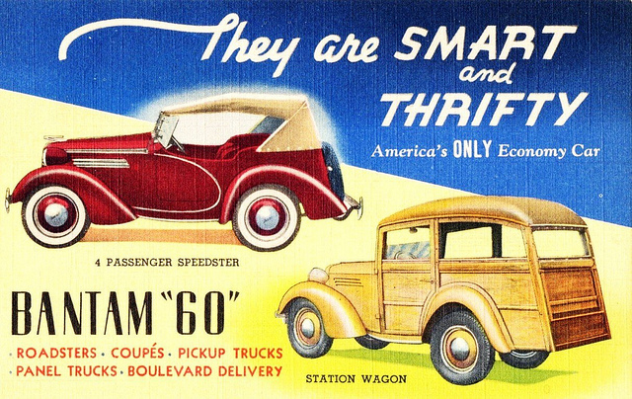
Chapter 1: Economic Basics The Role of the Consumer
Notes:
CONSUMER INFLUENCE ON PRODUCTS
ask students what they have purchased over the last month.
ask them if the colour, style, size, or other options mattered?
ask them to identify style and colours for clothes that are “in” now?
ask them to consider what information businesses get from their buying habits.
the shift from business controlling the marketplace to more consumer control took place during the 1950s.
When Products Become Obsolete
Examples:
Treadle sewing machines, stem-powered locomotives (trains), wringer washer, and manual typewriters are examples of product that have become obsolete.
The service of delivering coal and ice to people’s homes is also an example of obsolescence.

Slide 13
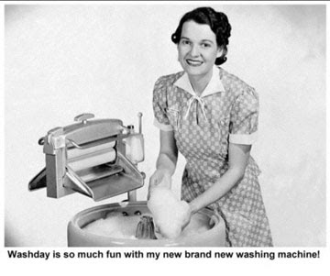
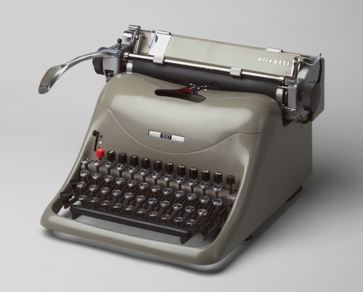
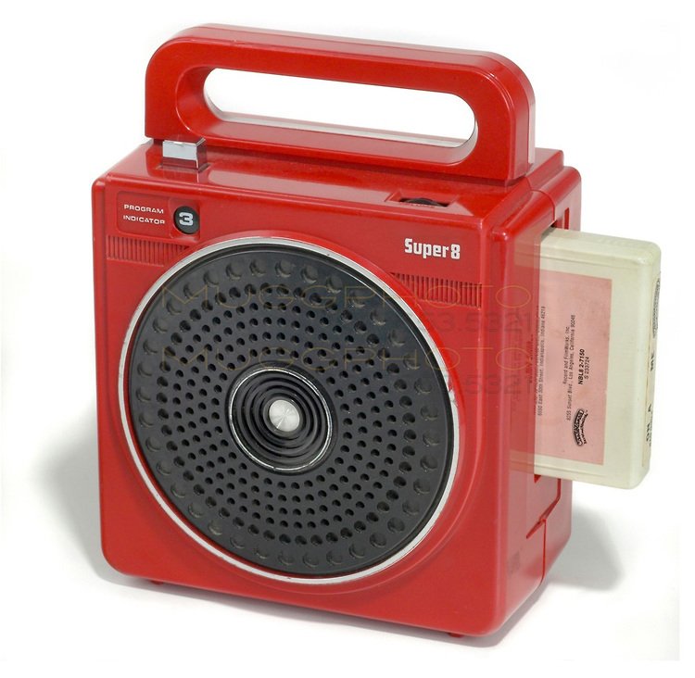
Chapter 1: Economic Basics The Role of the Consumer
b. When Products Become Obsolete
Over time, products or services can become obsolete because people no longer want them or new and improved products have replaced them.
Notes:
CONSUMER INFLUENCE ON PRODUCTS
ask students what they have purchased over the last month.
ask them if the colour, style, size, or other options mattered?
ask them to identify style and colours for clothes that are “in” now?
ask them to consider what information businesses get from their buying habits.
the shift from business controlling the marketplace to more consumer control took place during the 1950s.
When Products Become Obsolete
Examples:
Treadle sewing machines, stem-powered locomotives (trains), wringer washer, and manual typewriters are examples of product that have become obsolete.
The service of delivering coal and ice to people’s homes is also an example of obsolescence.

Slide 14
Your Thoughts
Provide an example of an obsolete good or service (one not already used today).
Have DVD players made VCR players obsolete?
Are digital cameras making film cameras obsolete? Explain.

Slide 15
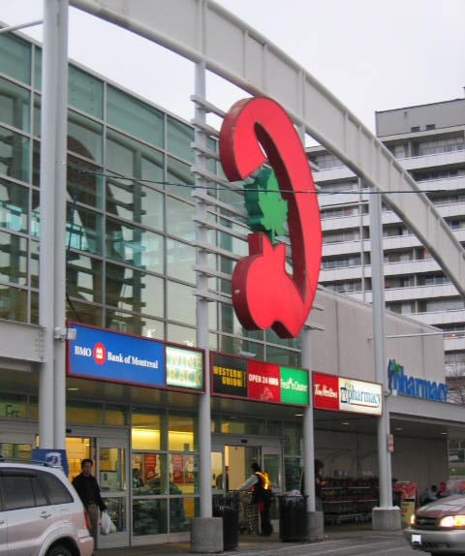
Chapter 1: Economic Basics The Role of the Consumer
c. Consumer Influence on Price
Businesses are in control when they have pricing power.
When businesses are in control and can charge high prices and raise prices when costs go up
Consumers have control when they have power. Today’s consumers want access to a wide variety of cheap, reliable goods and services
What happens if businesses do not give them the services they want?
They demonstrate this by “voting with their feet” to look elsewhere for products and services.
Notes:
CONSUMER INFLUENCE ON PRICE
Consumers want access to a wide variety of inexpensive, reliable goods and services.
In the 1950’s, when businesses had a greater degree of pricing power they offered a limited variety of products.
Today we have a wider range of brands and a broader price range to choose from (example cereal).
When setting a price for a product, producers have to consider what the customer will pay for it in addition to the cost of producing it.
Similar products will be in the same price range as competitor's products.
CONSUMER INFLUENCE ON SERVICE
Consumers have influenced restaurant service. Customers, at one time, had to go into and eat at the restaurant When take-out started customers had to go into the business to get the food. Some restaurants started offering drive-thru, and others followed suit. At first it was mainly pizza businesses that offered delivery. Now other restaurants such as Swiss Chalet have started offering delivery service. Even grocery stores, such as Dominion, have been influenced by consumers and now offer take-out and delivery.

Slide 16
Chapter 1: Economic Basics The Role of the Consumer
d. Consumer Influence on Service
Competition in business has given power to the consumer
Consumer purchasing power gives individuals the control to buy
goods and services at the price they want and the location they like.
This power influences the products, prices, and service levels that businesses offer consumers.
DVDs are a good example
Specialty stores
Department stores
Online rentals
Netflix
On Demand
An increasing range of choice for consumers encourages businesses to continually improve their services to compete for consumer dollars.
Notes:
CONSUMER INFLUENCE ON PRICE
Consumers want access to a wide variety of inexpensive, reliable goods and services.
In the 1950’s, when businesses had a greater degree of pricing power they offered a limited variety of products.
Today we have a wider range of brands and a broader price range to choose from (example cereal).
When setting a price for a product, producers have to consider what the customer will pay for it in addition to the cost of producing it.
Similar products will be in the same price range as competitor's products.
CONSUMER INFLUENCE ON SERVICE
Consumers have influenced restaurant service. Customers, at one time, had to go into and eat at the restaurant When take-out started customers had to go into the business to get the food. Some restaurants started offering drive-thru, and others followed suit. At first it was mainly pizza businesses that offered delivery. Now other restaurants such as Swiss Chalet have started offering delivery service. Even grocery stores, such as Dominion, have been influenced by consumers and now offer take-out and delivery.

Slide 17
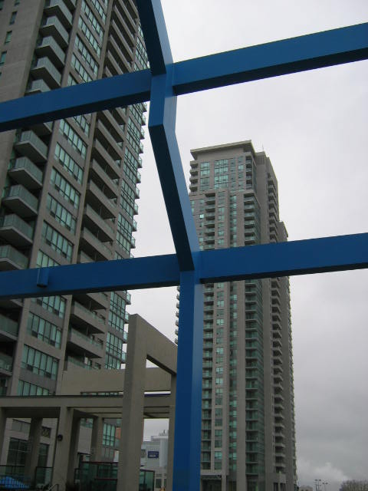
Chapter 1: Economic Basics Starting a Business
Characteristics of Entrepreneurs
Entrepreneurs are individuals who are risk-takers and problem-solvers.
They are acutely aware of opportunities in the marketplace and take advantage of these in their businesses.
Important entrepreneurial characteristics include the following:
Can you think of advantages and disadvantages of being an entrepreneur?
Complete Danny Williams profile.
self-confidence
a flair for innovation
the ability to work alone
an aptitude for managing others
Notes:
CHARACTERISTIS OF ENTREPRENEURS
self-confidence: self-assured and positive and confident in their ability to run a business including purchasing, marketing, and accounting.
a flair for innovation: improving upon what is being done in the marketplace and anticipating future consumer needs and wants.
the ability to work alone: initiative and drive to accomplish tasks and meet deadlines on one’s own
an aptitude for managing others: the ability to motivate others to achieve objectives
CONSUMER NEEDS AND WANTS
Examples of needs include; food, basic clothing, and shelter.
Examples of wants include; I-pod, plasma TV, a designer purse, and a Rolex watch.

Slide 18
Chapter 1: Economic Basics Starting a Business
Consumer Needs and Wants
Entrepreneurs often start businesses to satisfy consumer needs.
Needs are things that are necessary for survival such as food, clothing, and shelter.
In a country as prosperous as Canada, the majority of Canadians have met their basic needs.
However, entrepreneurs can also provide consumers with new products or services that are not considered a need but a want—things that are not necessary for survival, but that add comfort or pleasure to their lives.
Notes:
CHARACTERISTIS OF ENTREPRENEURS
self-confidence: self-assured and positive and confident in their ability to run a business including purchasing, marketing, and accounting.
a flair for innovation: improving upon what is being done in the marketplace and anticipating future consumer needs and wants.
the ability to work alone: initiative and drive to accomplish tasks and meet deadlines on one’s own
an aptitude for managing others: the ability to motivate others to achieve objectives
CONSUMER NEEDS AND WANTS
Examples of needs include; food, basic clothing, and shelter.
Examples of wants include; I-pod, plasma TV, a designer purse, and a Rolex watch.

Slide 19
Chapter 1: Economic Basics Starting a Business
Attracting Consumer Interest
Entrepreneurs need to identify their competition. They must determine how to attract their customers and keep them.
Businesses also plan what goods and services to offer and
how to distribute and market them by knowing how consumers
will answer the following questions:
Do I really need it?
Where should I buy it?
How much variety is there to choose from?
How much can I afford to spent?
Why would I want to buy here? Are there sales or coupons?
Where else could I get it? Could I buy it used or get it as a gift?
Notes:
ATTRACTING CONSUMER INTEREST
Surveys (feedback) can give businesses information about consumer wants, needs, and preferences.

Slide 20
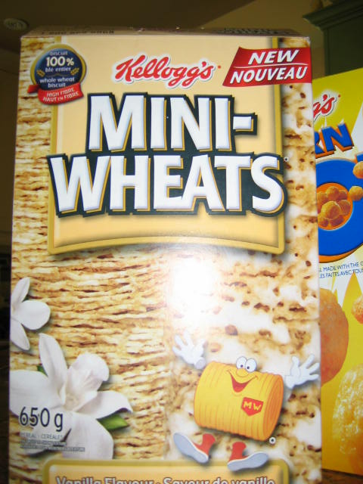
Chapter 1: Economic Basics Starting a Business
Attracting Consumer Interest
Businesses compete for consumers. Here are
a few strategies that businesses use to help
attract buyers to try a product or service.
Create something new and/or improve it.
Promote the latest trends.
Compete with similar businesses.
Making Good Business Decisions
Entrepreneurs face many decisions on a daily basis. Even deciding how much inventory or stock (i.e., the quantity of goods and materials to keep on hand) must be considered carefully because of the financial resources available.
Notes:
ATTRACTING CONSUMER INTEREST
Strategies:
“New and Improved”
Many products compete for your breakfast dollar; Kellogg’s (Mini-Wheats), Wonder (bread), Old South (orange juice), Nestle (Carnation instant breakfast), Danone (yogurt), etc.
What you ate for breakfast could have depended on price, taste preference, promotion, health concerns, or some other factor. What might another factor be?
Businesses come up with “new and improved” products, that they think will be better than the competition’s, through research and testing.
Breakthroughs that give a business an advantage can translate into profits for the business.
Promoting Treads
Advertising or product placement in movies, videos and on television.
Competing with Similar Businesses
Not the same types of businesses; fast-food outlets, restaurants, grocery stores, catering businesses, meal plan services, etc., all compete against each other for consumer’s money in an effort to make a profit.

Slide 21
Chapter 1: Economic Basics Starting a Business
Decision-Making Process
Notes:
DECISION-MAKING PROCESS
Determine what decision has to be made.
Clearly define the question to be answered. Formulate it so that you will be able to test or measure if you made the correct decision or not.
2. Identify the alternatives. Develop and state clearly several courses of action or actions that you could take to answer your question or problem.
3. Evaluate the advantages and disadvantages of each alternative. For each of the alternatives that you have identified state the advantages and the disadvantages of each course of action. All decisions have a benefit(s) and a drawback(s).
4. Make a decision and take action. Choose among the alternatives that you have identified. Put the decision into action. Take the steps to implement it.
5. Evaluate the decision. After sufficient time for your decision to run its course, review your decision. Did it do as you had planned? Where the disadvantages too high? Did the advantages of the decision that you opted for measure up to the your expectations.

Slide 22
Ethical, Legal, Moral Considerations
Topic: Should it be legal to sell lemon-flavoured drinks laced with nicotine in a corner store?
Nic lite News C-store

Slide 23
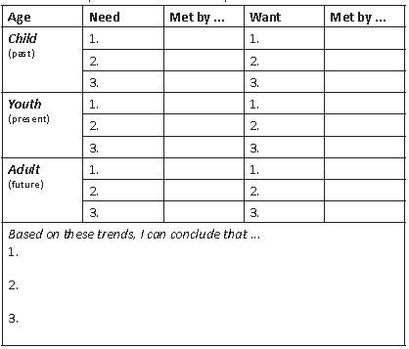
Consumer Needs and Wants Con’t
Activity 1: Handout
What are some of your most important needs and wants? How do you satisfy these demands? How does this change over time? Compare your response with a partner. What is similar? What is different? What inferences can you make from this comparison?

Slide 24
Consumer Needs and Wants Con’t
Economic Systems (the way people meet their needs and wants):
Subsistence
Barter
Market economies

Slide 25
Consumer Needs and Wants Con’t
Subsistence Economy
an economy which is not based on money
in which buying and selling are absent; and
which commonly provides a minimal standard of living
People provide their own needs and wants through physical means (catch/grow their own food, build their own shelter, etc)
Typically only found in very isolated regions as well as in your history books

Slide 26
Consumer Needs and Wants Con’t
Advantages of a substance economy:
Your food can’t get any more organic!
Very sustainable – they consume only what they need; relying on the renewable nature of the world
Greed, while undoubtedly present, is minimalized
Can you think of any more?

Slide 27
Consumer Needs and Wants Con’t
Limitations of a substance economy:
Very low standard of living
Would not produce many advances in technology (typically only tools that met only our needs and not our wants)
Very few wants would be met
Can you think of any more?

Slide 28
Consumer Needs and Wants Con’t
Barter Economy
A method in which goods and services are exchanged for other goods and services
In today’s world it is rarely the only system in any one society (usually have both a market place and bartering)
Think back to junior high social studies – merchants in NL! C’mon, think harder…
E.g. In Spain there is a growing number of exchange markets. These barter markets work without money. Participants bring things they do not need and exchange them for the unwanted goods of another participant. Swapping among three parties often helps satisfy tastes when trying to get around the rule that money is not allowed.
Can you think of any local or regional shops that barter?

Slide 29
Consumer Needs and Wants Con’t
Advantages of Bartering Economy:
Environmental impact – rather than disposing unwanted goods, many are reused
You don’t have to spend extra money
If you are not bartering for a profit, you do not have to pay income tax
Inflation has no affect
Can you think of any more?

Slide 30
Consumer Needs and Wants Con’t
Limitations of Bartering Economy:
Absence of a common measure of value – with money, it is easy to discern which objectively more valuable
Indivisibility (cannot be sold in pieces e.g. car, washer) of certain goods - If Person A wants a washer and Person B wants dishes and Person A does not haven enough dishes to equal the worth of a washer, a trade cannot be done.
Taxation – You are taxed if you barter for a profit
Can you think of more?

Slide 31
Consumer Needs and Wants Con’t
Market Economies
This is the economy we are most familiar with
An economy in which decisions regarding investment, production, distribution and prices are based on supply and demand
Money is introduced here
Everything is given a monetary value
Creates much more wealth than the other systems
Has brought us into the world we live in now

Slide 32
Consumer Needs and Wants Con’t
Advantages to Market Economies
Money flows to where it will get the greatest return, which causes the economy to grow (greater wealth in society)
If you have a great idea that meets the wants of consumers, it is possible to build great wealth
Has helped society build an overall greater quality of life
Allows for so many wants to be met
Can you think of any more?

Slide 33
Consumer Needs and Wants Con’t
Limitations to Market Economies
With consumption really high, there is negative environmental impact
For those who choose not to participate, have poor luck, or do not have a skill set to meet the demands of the world, poverty can be harsh
Some argue it places too much importance on meeting wants as opposed to needs
Can you think of any more?

Slide 34
Consumer Needs and Wants Con’t
Why did we go from one economic system to another?
Substance to Barter:
Barter to Market:

Slide 35
Activity #2 (Handout)
Activity 2: In groups of 7 or 8, create a bulletin board display which illustrates the ways in which economic systems have changed over time
Choose a leader to subdivide within your group and delegate which system is to be done by whom or if you will do one at a time and break each into smaller parts
The leader will be responsible for ensuring that all sub groups work together in creating a cohesive 3-part display
The leader will ensure that all members are given fair responsibility
Ensure that the following questions are answered:
Why did these changes in economies occur?
What are the positive and negative consequences of each?
There will be a presentation
5-7 minutes in length
All members will take part
Grading Rubric following …

Slide 36
Activity #2 (Handout)
Content
3 Sections – Each subgroup will manage their own
3-4 images will be expected per sections
Include captions for images if you feel the need is there
Be sure to include the following information for each system:
Examples of needs and wants and how they were met
Positive and negative consequences
Why society switched from one system to the next
I expect more examples/expansion than what was given in class
Presentation
Be sure display is clearly visible to all people in the room
Make frequent eye contact
Do NOT read from your project
Project your voice
Review your part so that you may speak confidently
Keep it relatively short (5-7 minutes)
Have one presenter move to the next fluently – practice!

Slide 37
Activity #2 (Handout)
Example assignment – partially completed
Be prepared to be amazed… The artist is clearly a trained professional by the name of Artesian Wells
***please aim higher than this individual***
***and use only as a guide***

Slide 38
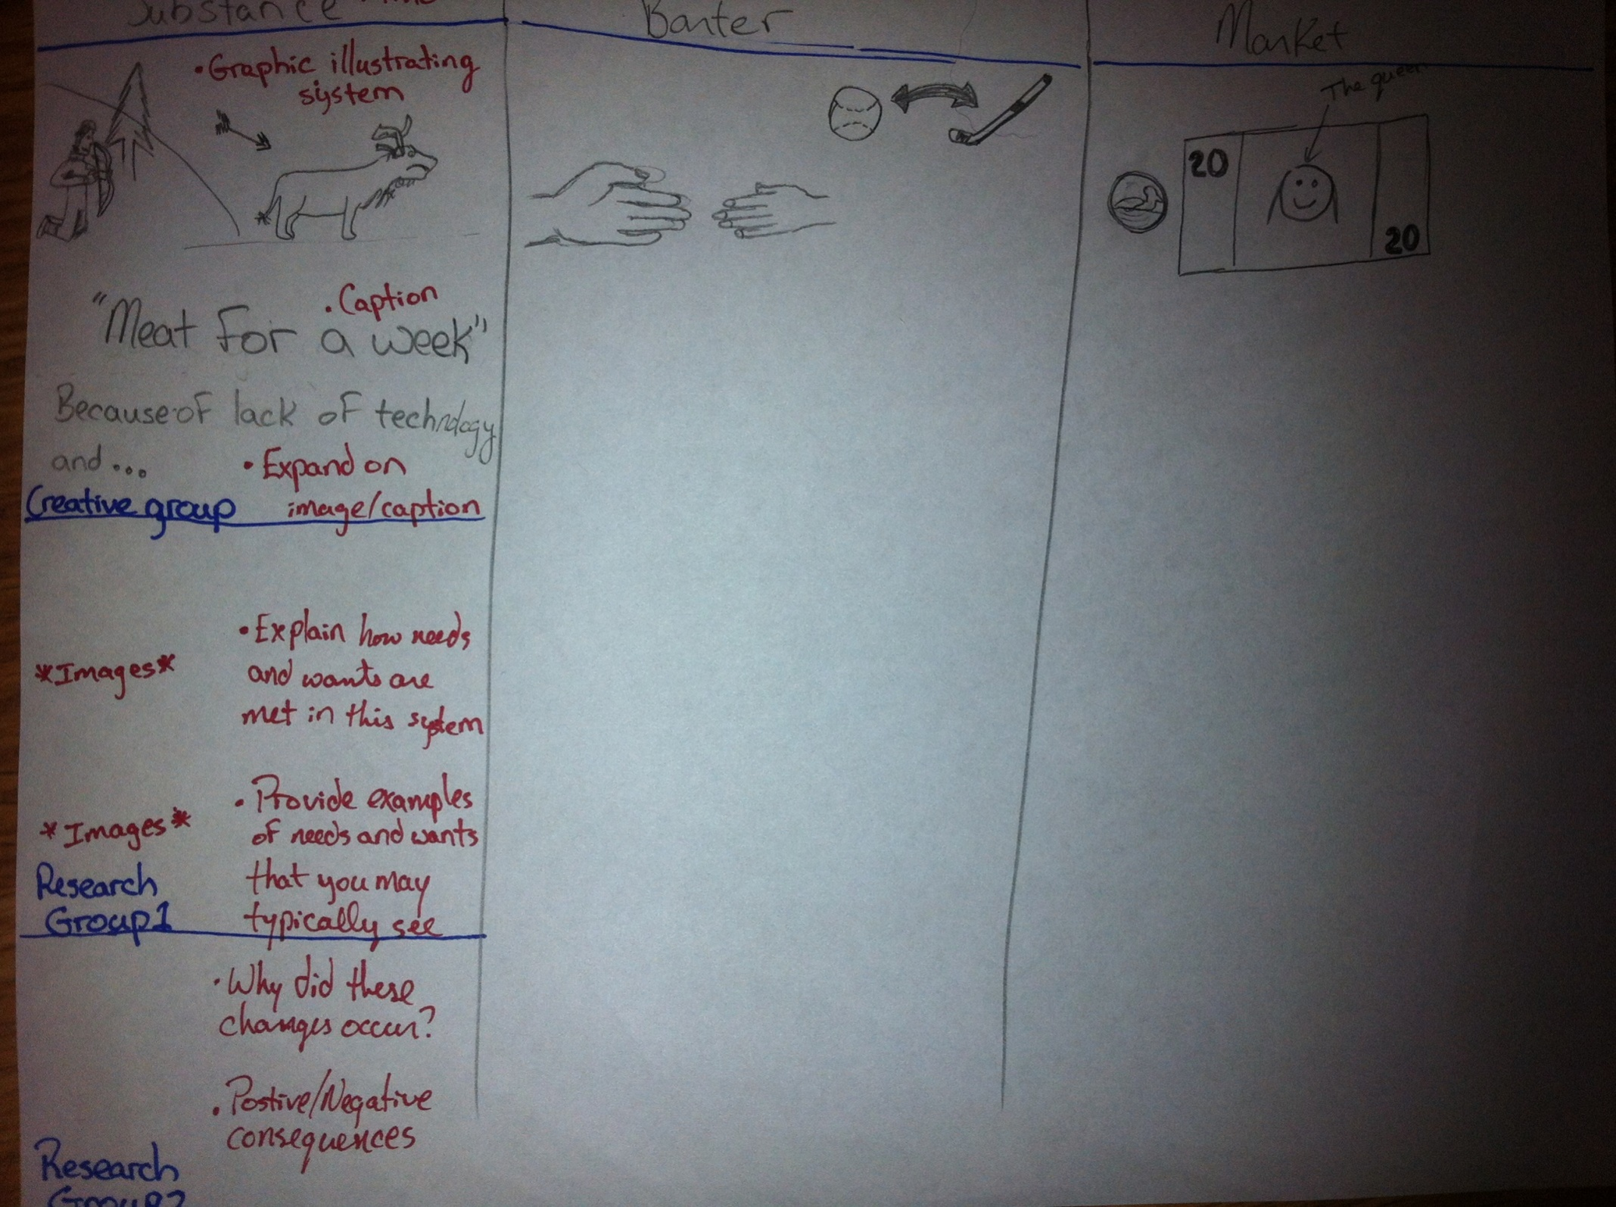

Slide 39
Chapter 1: Economic Basics Economic Resources
Economic Systems
Economic systems are a way of dealing with the selection, production, distribution, and consumption of goods and services. Government and business work together to foster activity and growth in the marketplace.
Economic systems have to answer three key questions:
What goods and services should be produced within the system?
For whom should these goods and services be produced?
How should these goods and services be produced?
Notes:
ECONOMIC SYSTEMS
An example of government and business working together could include addressing the energy shortage that countries such as Canada face.
Existing oil supplies are shared in a fair way due to government and businesses working together.
They are also working together to develop other forms of energy such as nuclear, hydro, solar, and wind.

Slide 40
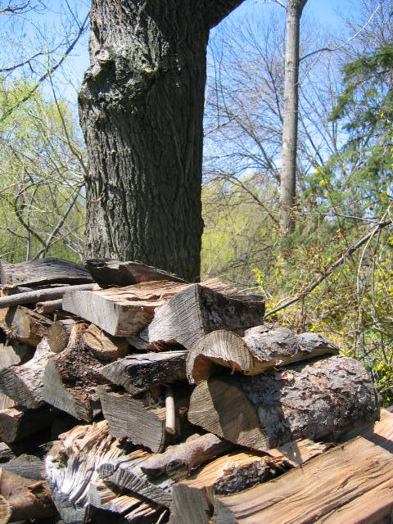
Chapter 1: Economic Basics Economic Resources
Economic resources, also known as factors of production, are the means through which goods and services are made available to consumers.
Most products require a combination of
natural resources
human resources
capital resources
Businesses are interdependent, which means they rely on the goods and services from a variety of businesses to satisfy consumer needs and wants.
Notes:
ECONOMIC RESOURCES
natural resources;
Materials that come from the earth, water and air.
Soil, iron ore, gold, oil, trees, wildlife, agricultural goods, fish, and oxygen are examples of natural resources used in the production of goods and services.
Most natural resources are non-renewable and limited (some take many years to replenish), therefore businesses are restricted in what they can build and create.
human resources;
Sometimes referred to as labour, human resources are the people who work to create the goods and services.
Examples include farmers, teachers, factory workers, construction workers, nurses, and social workers.
capital resources;
Include buildings, equipment and machinery, tools, vehicles, and factories that usually last for a long period of time and may require a substantial investment.
Money is also considered a capital resource, it is needed by businesses to buy raw materials and pay for human resources needed to produce goods and services.
Interdependence
A fast-food restaurant relies on materials that they get from a wholesale business such as beef, tomatoes, and potatoes (natural resources), they have to purchase the building or lease in which they operate and they would have had to purchase grills and refrigerators (capital resources) from a company that sells restaurant equipment. They will also need cooks, managers, and servers (human resources) acquired perhaps through an employment agency.

Slide 41
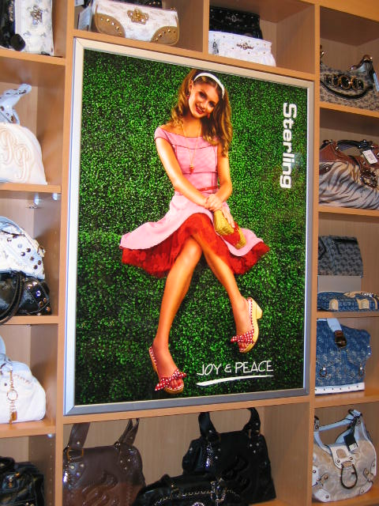
Chapter 1: Economic Basics Demand, Supply, and Price
Law of Demand
Demand is the quantity of a good or service that consumers are willing and able to buy at a particular price.
Law of demand and its relationship to prices and consumers is defined as the following:
When prices ⬇ decrease consumers buy more and demand goes up ⬆.
When prices ⬆ increase consumers buy less; demand goes down ⬇.
Several conditions that create demand are
consumer awareness
price
supply
accessibility
Notes:
LAW OF DEMAND
People have different needs and wants and different levels of ability, therefore we have different demands.
When we buy goods, or use a service, we express a demand for it.
Several conditions create demand:
consumer awareness: Through marketing and advertising, businesses create awareness and interest in the goods or services that they offer.
supply: An ample supply of the good or service available to consumers.
price: The good or service offered at a reasonable and competitive price.
accessibility: The product or service must be obtainable for the consumer to purchase. “Location, location, location” is a popular business motto that stresses the importance of the physical location of a business operation.
See table 1.2 for “Factors That Can Increase or Decrease Demand”

Slide 42
Chapter 1: Economic Basics Demand, Supply, and Price
Law of Supply
Supply is the quantity of a good or service that businesses
are willing and able to provide within a range of prices that
people would be willing to pay. Increasing the quantity
supplied as prices increase is called the law of supply.
Several conditions that affect supply are
the cost of producing or providing a good or service
the price consumers are willing to pay for it
Relating Price to Supply and Demand
Price is determined by supply and demand as well as the
cost of producing or providing the good or service.
Notes:
LAW OF SUPPLY
Businesses satisfy people’s needs and wants by providing goods and services at a profit.
Efficient businesses produce more, with the same resources, than less efficient ones.
As prices for a product or service increase, produces can use the increased revenue to provide more goods and services.
More revenue means a business can pay more overtime, expand factories, hire more employees, and buy more productive equipment.
Several conditions affect supply:
Occasionally, demand for a new good or service is created by supplying it for sale in the marketplace, and marketing as well.
See table 1.3 for “Factors That Can Increase or Decrease Supply”
RELATING PRICE TO SUPPLY AND DEMAND
When consumer demand is high while supply is low, prices will tend to be high.
When consumer demand is low while supply is high, prices will tend to be low.
Because demand and supply constantly change, prices tend to fluctuate.
High prices usually decrease the quantity demanded.

Slide 43
Price

Slide 44
Change in Supply

Slide 45
Change in Demand

